Slide 1

iMPACT OF coVID-19 ON CRIMES IN la cOUNTY
Yan Sun, Sidong Wang, Shangshang Wang, Ruiqi Zhu

Slide 2




Team Introduction
Ruiqi Zhu
UCLA 2020
Applied Math & Econ
Incoming MS student at Columbia University
Shangshang Wang
UCLA 2020
Statistics & Financial Actuarial Math
Incoming MS student at Harvard University
Sidong Wang
UCLA 2020
Statistics & Applied Math
Yan Sun
UCLA 2020
Financial Actuarial Math & Statistics Incoming MS student at University of Chicago

Slide 3
Introduction
Dataset
COVID-19 and the subsequent lockdown in California had impacted almost all aspects of our lives.
Almost two months into the lockdown, we have received four warning emails from the UCLA Police Department regarding crimes near campus.
Can’t help but wondering: How had crimes been affected by the COVID-19 Pandemic and the resulting rising unemployment in LA county?
2010-2020 Crime dataset in LA county
2020 COVID-19 dataset by city in LA county
2010-2020 Employment in
LA county
Objectives
Analyze the factors related to Crimes Trend
changes of crimes in LA county by category from pre COVID-19 to post COVID-19
Explore the change in crimes by individual city in LA county from pre COVID-19 to post COVID-19
Predict the trend and number of crimes in LA county after gradual reopening

Slide 4
Timeline
Explore Crime Trend and related factors
Future Projection After Reopening
Map changes in Crimes by Area
Analyze Trends of Different Crime Categories
Time Series ARIMA Modeling
Data-Driven Suggestions for LAPD

Slide 5
Past Research
Related Academic Research
Campbell’s 2020 Research:
An increasing risk of family violence during the COVID-19 pandemic: Strengthening community collaborations to save lives
Zahran et. al’s 2015 Research:
Natural Disasters and Social Order: Modeling Crime Outcomes in Florida
What We Learned:
Post disaster/crisis, although number of crimes may decrease, certain categories of crime such as domestic violence could still increase.
What We Learned:
Pay close attention to changes in Domestic Violence and Child Abuse & Neglect Cases

Slide 6
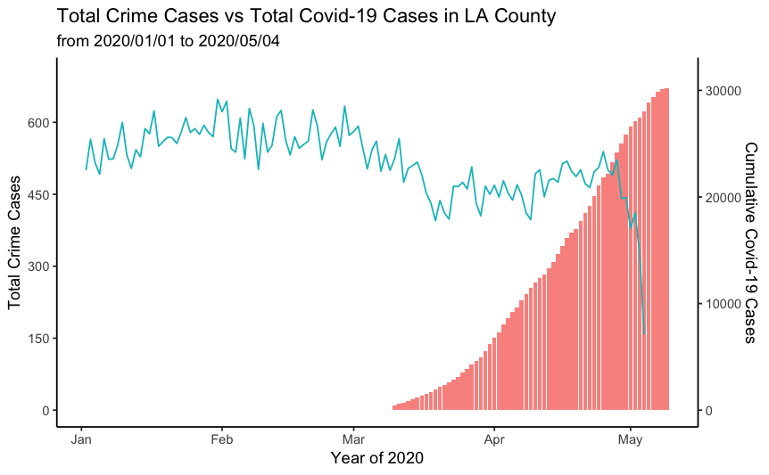
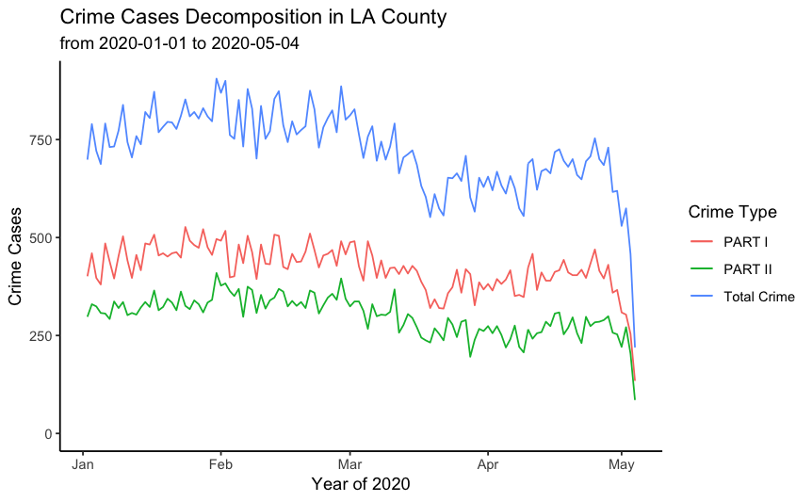
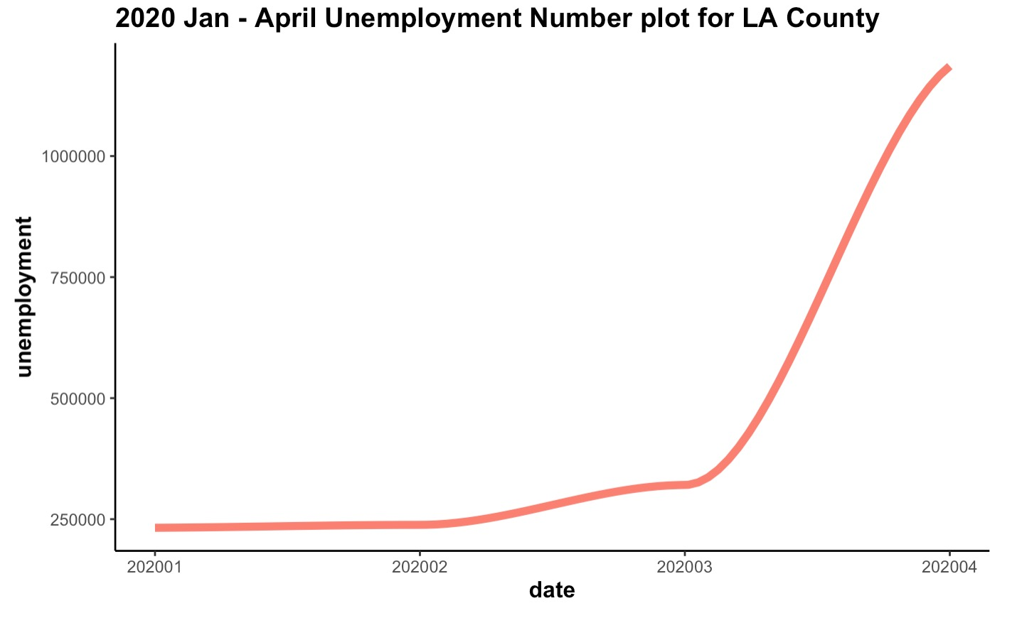
General Trend Pre-COVID and Post-COVID
COVID starts Spreading
Mar.19th Lockdown
1
Over all numbers of crimes have been as the number of COVID-19 infections increased
Although both categories of crimes decreased as COVID-19 spread, serious felonies decreased more drastically than non-serious crimes.
Part I Crime: Homicide, rape, aggravated assault, larceny, arson…
Part II Crime: ”Less Serious” Offenses including
2
GLM model confirms that factors affecting changes in crimes include: unemployment rate and number of COVID Cases
3

Slide 7
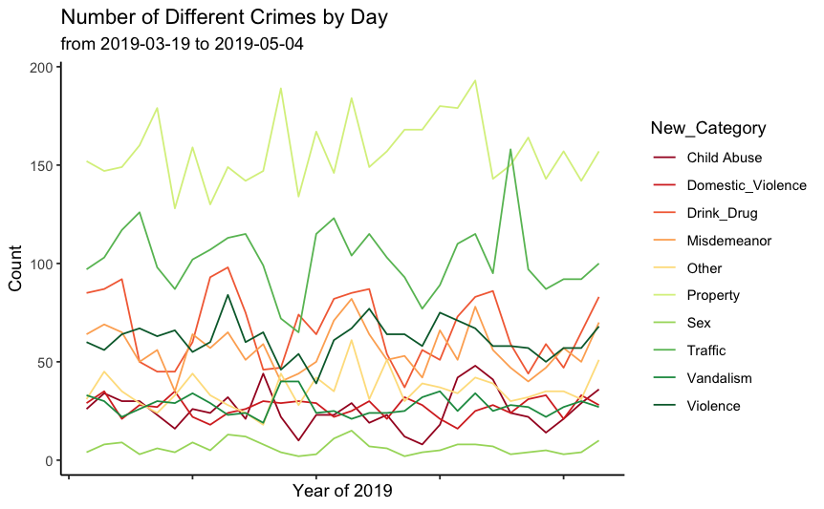
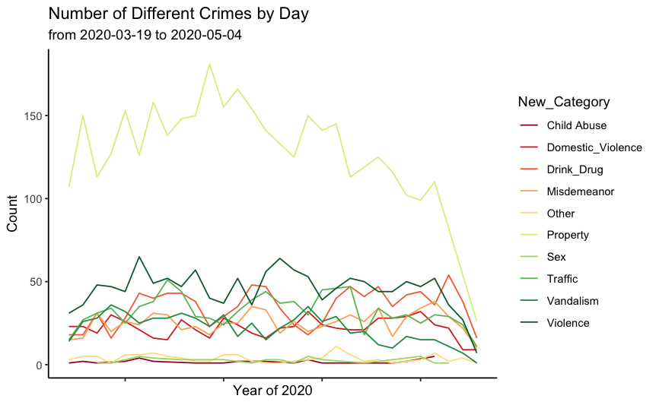
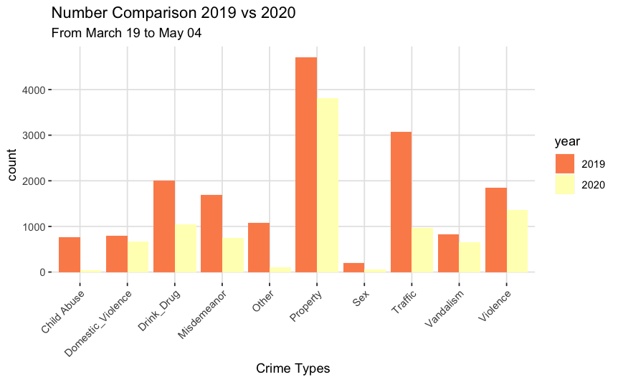
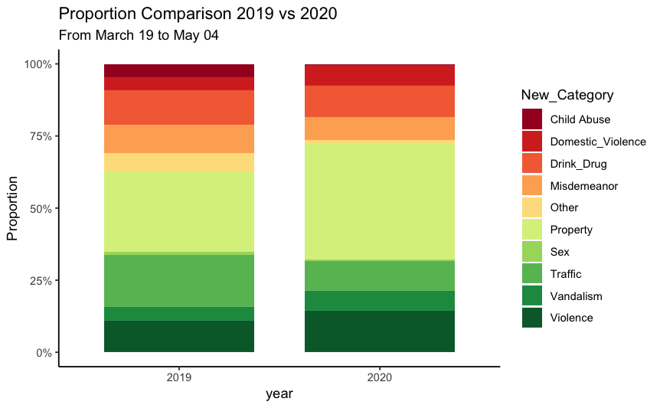
Taking a Closer Look at Crime Categories
1
Property Crimes Remains the category with highest numbers of cases
2
Traffic crimes decreased most drastically
As total crimes decreased, domestic violent did not decrease proportionally
3
4
Child Abuse and Neglect Crimes almost disappeared

Slide 8
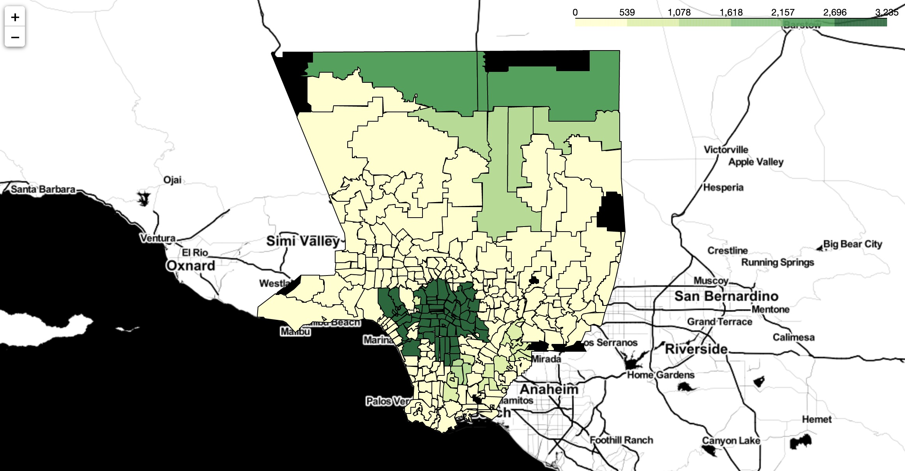
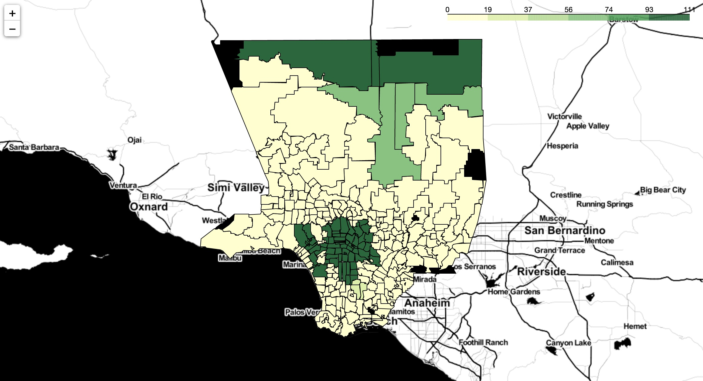
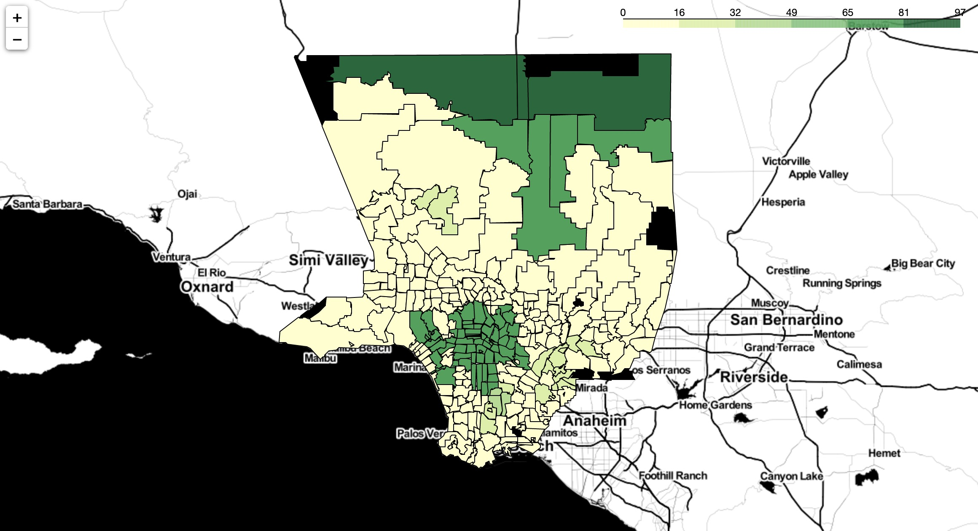
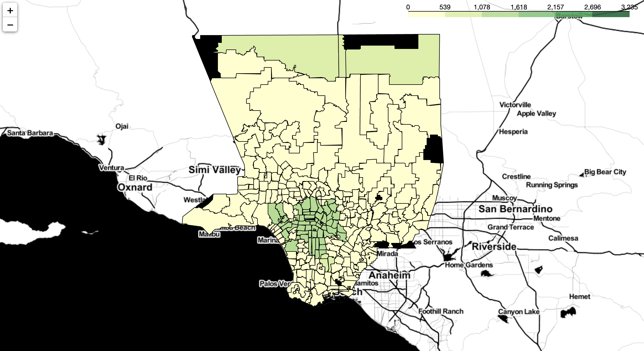
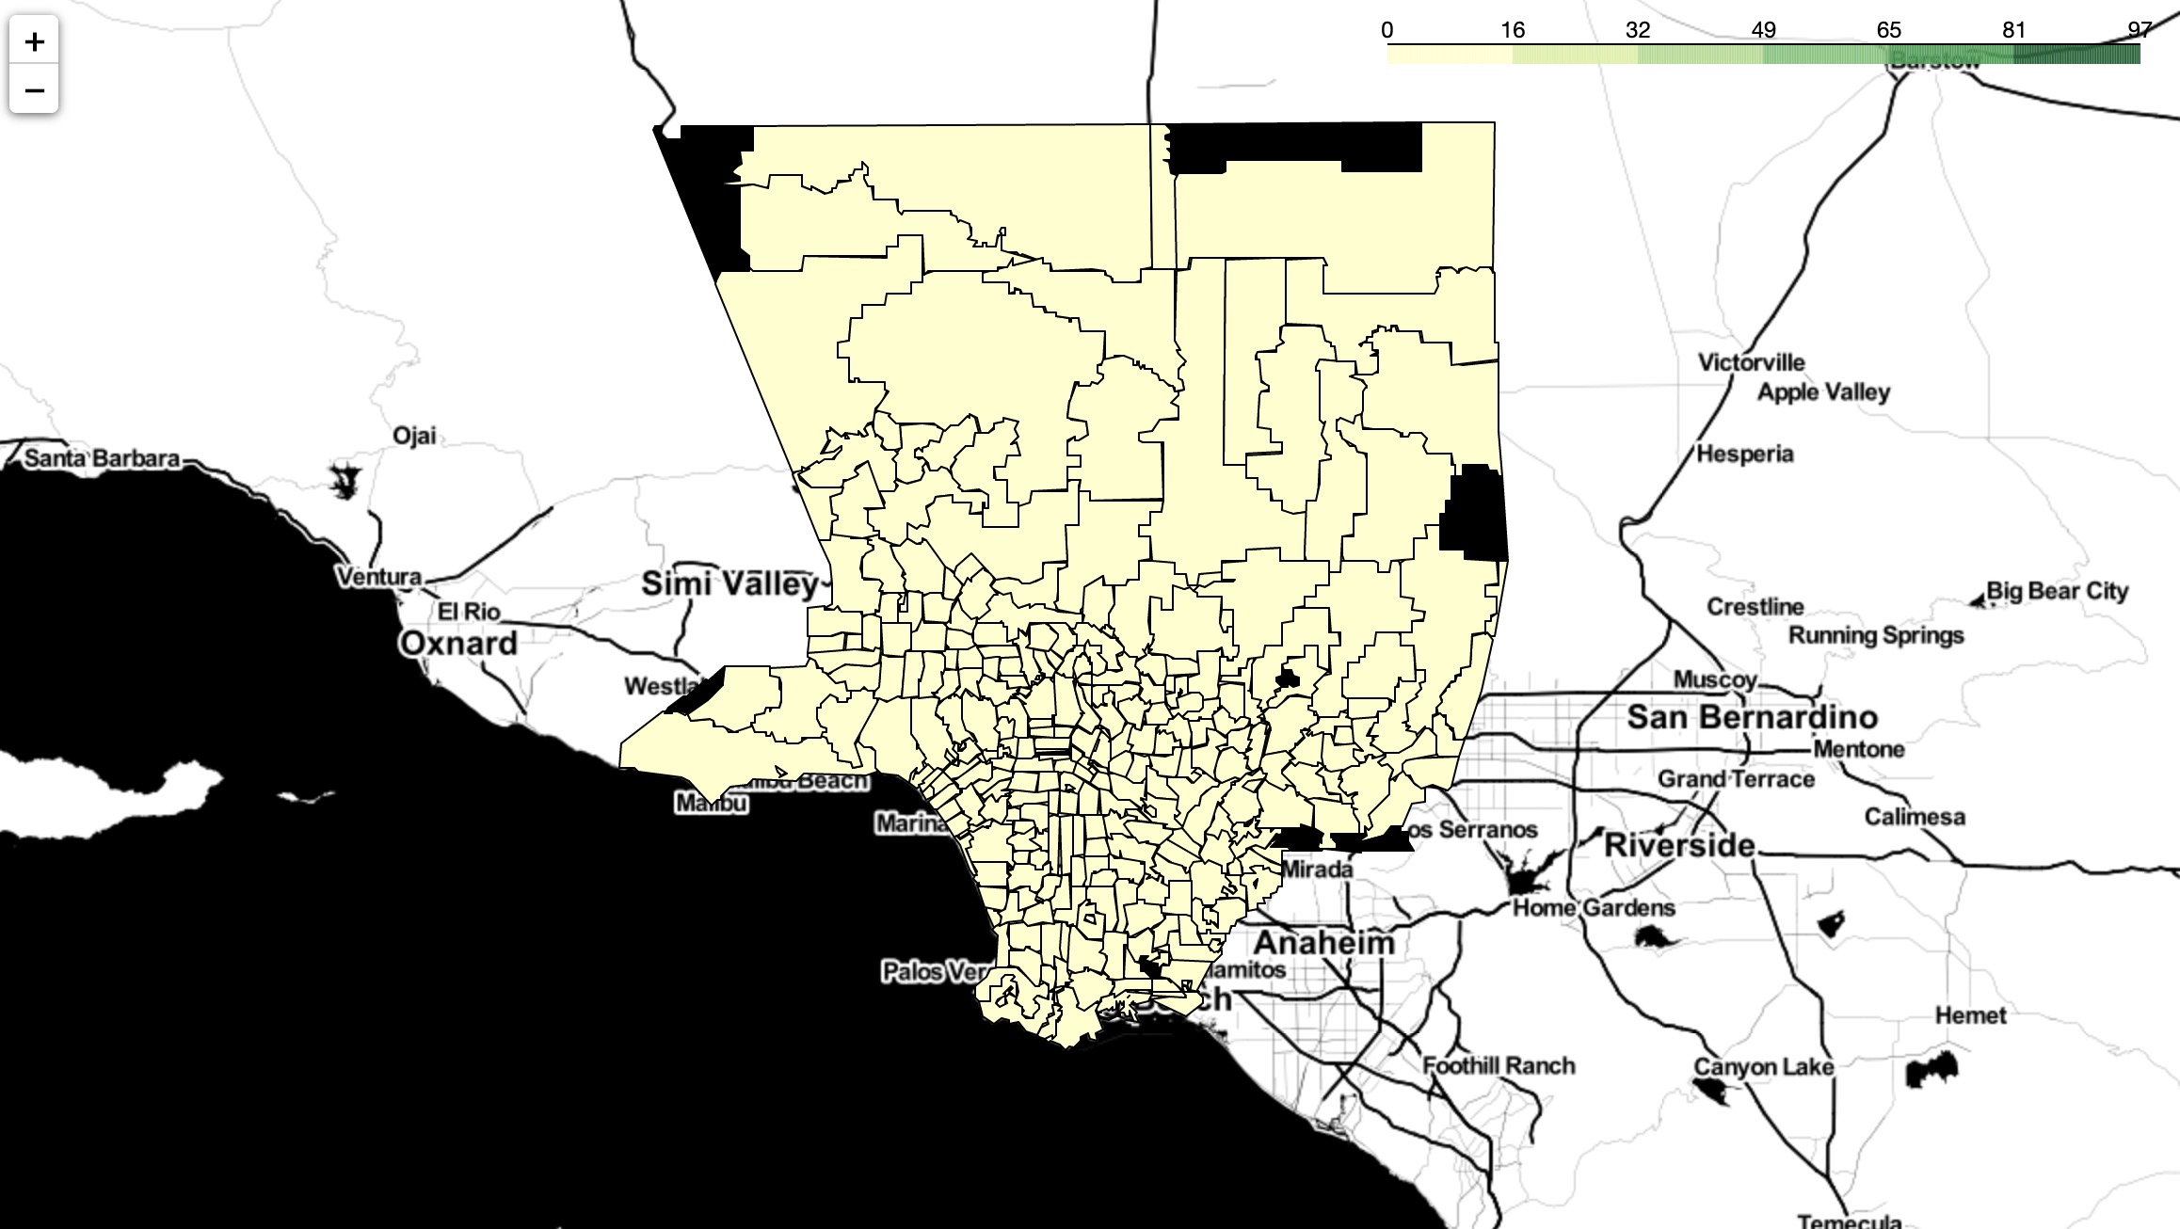

Take a Closer Look by area
2019 April Total Crime by City
2019 April Child Abuse & Neglect
2019 April Domestic Violence
2020 April Total Crime by City
2020 April Child Abuse & Neglect
2020 April Domestic Violence

Slide 9
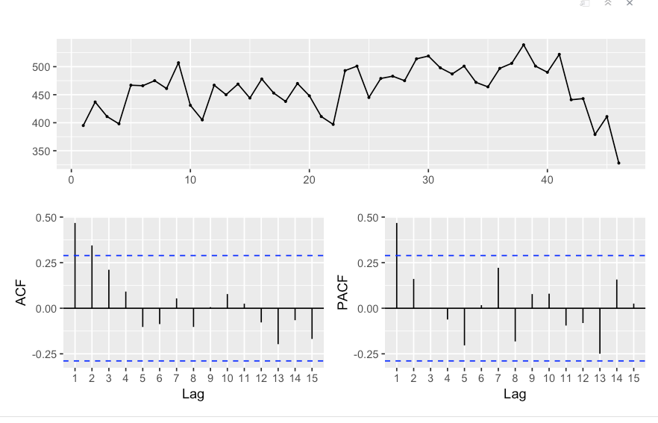

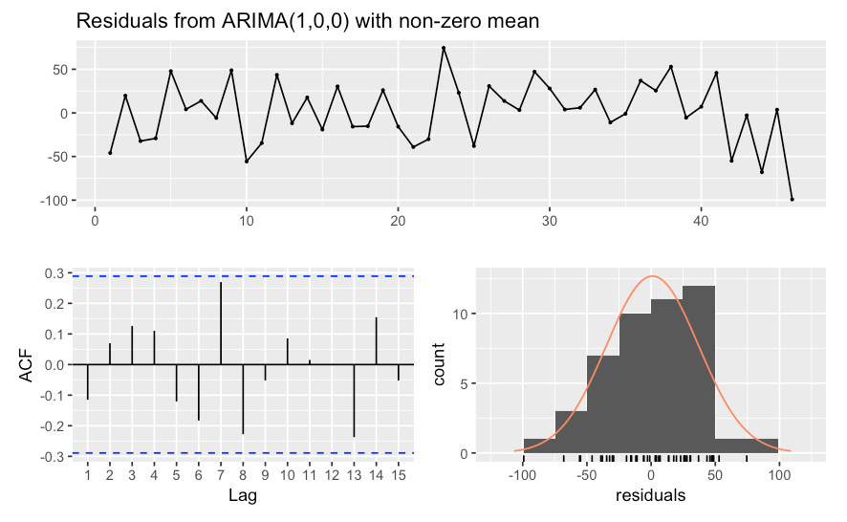
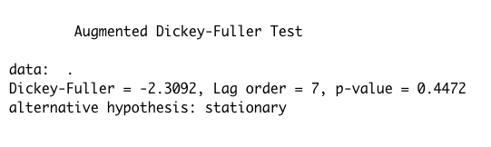
Projection with Short-term ARIMA(1,0,0) Model
Stationary Assumption Satisfied
Model Implementation

Slide 10
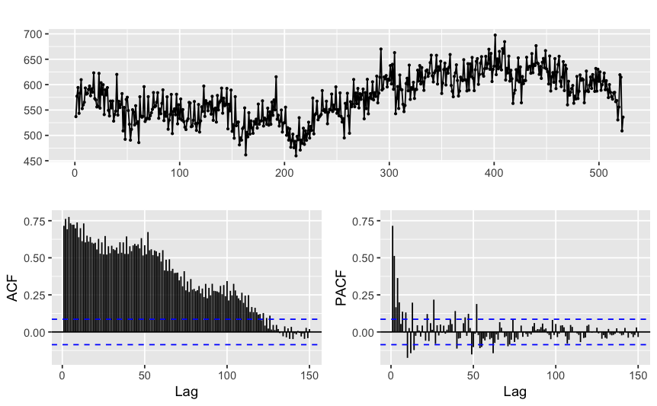
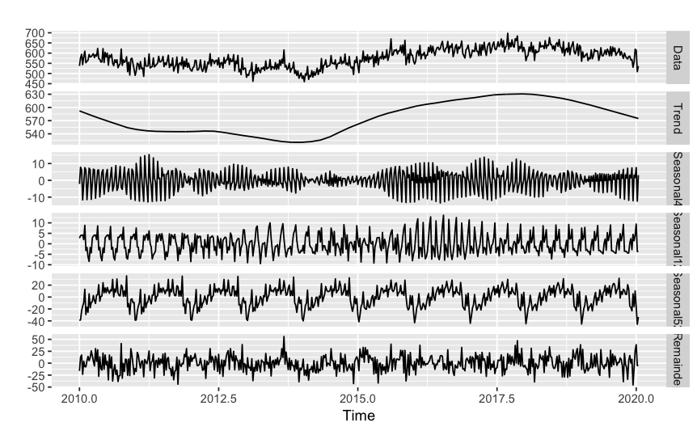
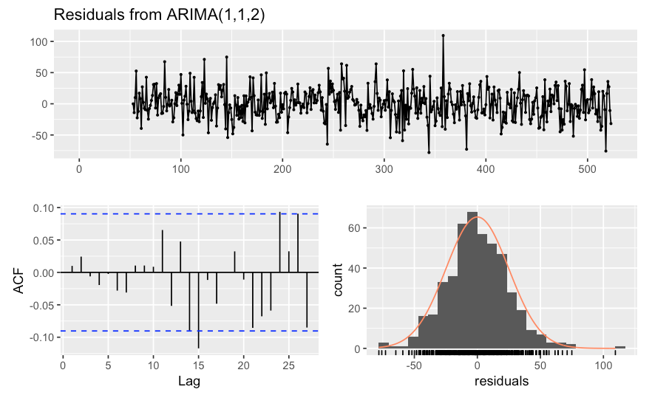
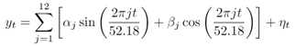
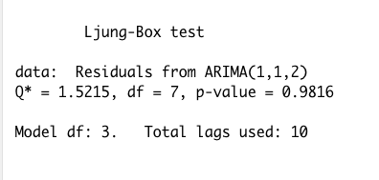
Long-term Dynamic Harmonic Regression Model
Seasonality
Residuals ～N(0, σ)
Project long-term criminality after reopening using 2010-2019 crime statistics
where η_t = ARIMA(1,1,2)

Slide 11
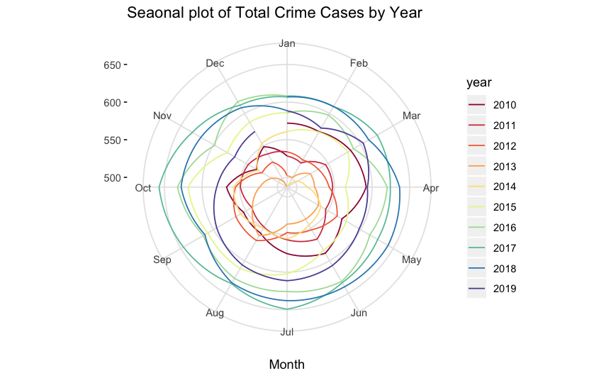
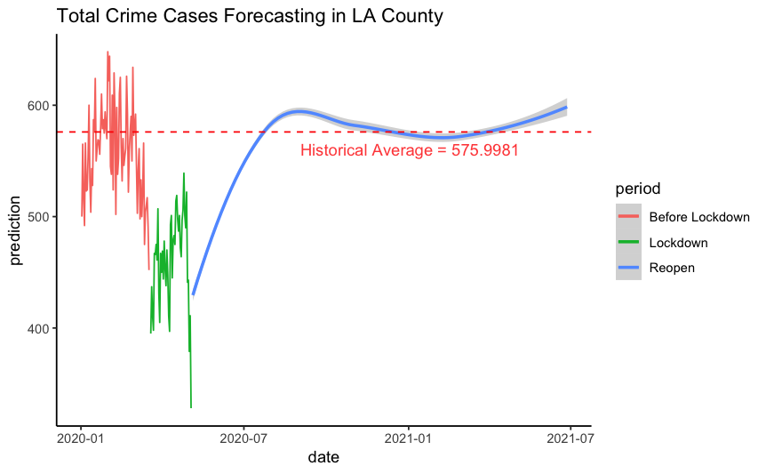
Future Projection
Based on our Time Series Analysis using short-term and long-term ARIMA Models, We project the total crimes in LA County to gradually increase after reopening and peak in the fall due to Seasonality.
Peak in August – October Due to Seasonality
Gradual Reopening

Slide 12






Discussion and Insight
Prepare for Increase of Total Crimes After Reopening
School and Community Should Monitor Child Abuse and Neglect
Residents and the Police Department should prepare for the projected increase in crimes after reopening
Child abuse and neglected cases are anticipated to increase after end of lockdown. School and Community should closely monitor and report case.
Pay Close Attention to Certain Areas
Alcohol and Drug related Crimes
LAPD should focus on certain areas with historical high crime rate and highest unemployment rate such as South LA, Central LA and the Antelope Valley.
As social gathering would increase after reopening, Alcohol and Drug related Crimes would increase.
Provide Help For Domestic Violence Victims
Prepare for Increase in Traffic Crimes
Due to lockdown and fear for infection, domestic violence victims might not reach out or get the help they needed. Non-profit organizations and the LAPD should provide help for domestic violence victims
Although LA County has experienced a drastic drop in Traffic, residents and LAPD should increase increase in Traffic crimes as LA reopens. Plan constructions on highways during lockdown to prepare.

Slide 13
Thank You AND Stay Safe!
From Yan Sun, Sidong Wang, Shangshang Wang, Ruiqi Zhu

